Slide 1

AI-Powered Brain Tumor
Detection, Classification &
Segmentation System
Using Deep Learning
Presented by: Aryan Sengar (23CSU055)
Mentor: Dr. Ashima Rani
Third Year Project — B.Tech CSE | 2025–26
Python
TensorFlow
FastAPI
React
OpenCV
U-Net
May 2026

Slide 2
Introduction
Transforming Healthcare with AI-Driven Medical Imaging
Why This Project?
97.3%
90.0%
Brain tumors affect millions globally — early detection is critical for survival.
Manual MRI analysis by radiologists is time-consuming, subjective, and prone to inconsistencies.
AI-powered deep learning can automate screening, providing fast, consistent, and objective analysis.
This system integrates three specialized neural networks into a unified diagnostic pipeline — covering detection, classification, and pixel-level segmentation.
Detection Accuracy
Classification Acc.
0.80+
~23K
Dice Score
Training Images
3-Stage AI Pipeline
Detect
→
Classify
→
Segment
CNN → MobileNetV2 → U-Net

Slide 3
Problem Statement
Challenges in Traditional Brain Tumor Diagnosis
Manual Analysis is Slow
Expert radiologists take hours per case; delays treatment initiation in critical time windows.
High Inter-Observer Variability
Diagnosis consistency varies significantly between radiologists, leading to inconsistent protocols.
Subtle Features Easily Missed
Early-stage tumors have low contrast and may be overlooked by fatigued clinicians.
Scarcity of Expert Neurologists
Remote and underserved regions lack access to qualified specialists.
Solution: Deep learning automates MRI screening — processing thousands of scans with consistent, objective, 24/7 analysis.

Slide 4
Project Objectives
Four core goals of this deep learning system
01
02
Binary Tumor Detection
Multi-Class Classification
Build a CNN to classify MRI scans as Healthy or Tumor with high sensitivity and specificity.
Identify tumor subtypes — Glioma, Meningioma, Pituitary, No Tumor — using MobileNetV2 transfer learning.
03
04
Pixel-Level Segmentation
Full-Stack Web Application
Generate precise tumor boundary masks using a U-Net encoder-decoder for surgical planning.
Deploy all models via a React + FastAPI interface with PDF reports, batch analysis, and QR sharing.

Slide 5
Literature Review
Existing approaches and research gaps addressed by this project
Existing Approaches
Research Gaps & Our Contributions
Traditional CNNs
Gap: Single-Task Models
VGG, ResNet, Inception — strong baselines for medical imaging classification.
Our fix: Most existing work focuses on one task. We build an integrated 3-stage pipeline.
Transfer Learning
Gap: Segmentation Precision
ImageNet-pretrained models reduce training time and data requirements significantly.
Our fix: Vanilla U-Nets achieve ~0.70 Dice. Our BN+Dropout+Dice+BCE model reaches 0.80+.
U-Net Architecture
Gap: No Web Integration
Pioneered encoder-decoder structure with skip connections for biomedical segmentation.
Our fix: Literature models lack deployment. We deliver a full React+FastAPI web application.
Ensemble Methods
Gap: CPU Optimization
Combining models improves robustness but adds inference complexity.
Our fix: Most work assumes GPU. We optimize all three models for CPU-only training.

Slide 6
Proposed System
Multi-stage AI pipeline for automated brain tumor analysis
MRI / CT
Input
Preprocess
& Augment
CNN
Detection
MobileNetV2
Classify
U-Net
Segment
Report &
Output
→
→
→
→
→
If Healthy → Stop | If Tumor → Classify → Segment
Binary Detection
Type Classification
Tumor Segmentation
PDF Report Gen.
CNN — Grayscale 128×128
MobileNetV2 — RGB 224×224
U-Net — Pixel-wise mask
ReportLab — Auto clinical report
Batch Processing
QR Code Sharing
History Tracking
Area Estimation
Multiple MRIs in one session
Scan to access system on mobile
localStorage-based analysis log
Tumor % of total scan area

Slide 7
System Architecture
React Frontend · FastAPI Backend · TensorFlow Model Layer
FRONTEND LAYER
▸ DropZone • ResultPanel
React.js + Vite + Tailwind CSS + Framer Motion
▸ Dashboard • History Page
▸ Batch Analysis UI • QR Share
↕ HTTP/JSON
API LAYER
▸ /predict/binary • /predict/type
FastAPI + Uvicorn (Python Backend)
▸ /predict/segmentation • /predict/full
▸ /generate-report (ReportLab PDF)
↕ HTTP/JSON
MODEL LAYER
▸ CNN Binary Classifier (128×128 Grayscale)
TensorFlow / Keras + OpenCV + NumPy
▸ MobileNetV2 Multi-class (224×224 RGB)
▸ U-Net Segmentation (128×128 + Mask)

Slide 8
Dataset Details
Three curated datasets covering all pipeline stages
01
Binary Classification Dataset
Classes:
Tumor / Healthy
Source: Kaggle — MRI + CT Scans
Purpose:
Train CNN detector
Format: 2D PNG slices
02
Type Classification Dataset
Classes:
Glioma / Meningioma / Pituitary / No Tumor
Source: Kaggle — MRI Scans
Purpose:
Train MobileNetV2 classifier
Format: 2D PNG slices, RGB
03
Segmentation Dataset
Classes:
Tumor mask / Background
Source: Kaggle — MRI + Masks
Purpose:
Train U-Net segmenter
Format: 2D PNG slices
Total images across all datasets: ~22,946 | Formats: JPG, PNG, NIfTI | Test samples (CNN): 1,924

Slide 9
Data Preprocessing Pipeline
Input preparation for all three model stages
1
2
3
4
5
6
Load Images
→
Convert
→
Resize
→
Normalize
→
Augment
→
Split
JPG / PNG
Grayscale (CNN)
RGB (MobileNet)
128×128 (CNN)
224×224 (MNet)
128×128 (UNet)
Divide by 255
Pixel range
[0.0 – 1.0]
Rotate • Zoom
Flip • Shear
Balance classes
Train / Val
Stratified split
Ready tensors
Grayscale vs RGB Handling
Class Imbalance Strategy
Detection model uses single-channel grayscale. Classification uses 3-channel RGB. Handled separately in the preprocessing pipeline.
Balanced sampling + heavy augmentation applied. MobileNetV2 class-weighted loss function compensates for Meningioma under-representation.
Segmentation Mask Prep
Ground truth masks binarized at 0.5 threshold. Resized to match U-Net 128×128 output. Verified alignment with input slices.

Slide 10
Model 1 — Binary Classification (CNN)
Tumor vs. Healthy detection from grayscale MRI scans
CNN Architecture
Model Specifications
Input Shape:
128 × 128 × 1
Input
128 × 128 × 1 (Grayscale)
Optimizer:
Adam
Conv2D + ReLU
32 filters, 3×3 kernel
Loss Function:
Binary Cross-Entropy
Epochs:
10
MaxPooling2D
2×2 pool
Batch Size:
433 (CPU-optimized)
Output:
Sigmoid (Binary)
Conv2D + ReLU
64 filters, 3×3 kernel
MaxPooling2D
2×2 pool
Performance Results
Flatten → Dense
128 units + ReLU
97.3%
0.97
Dropout (0.5)
Regularisation
Test Accuracy
F1-Score
Output Dense
2 units → Sigmoid
Precision (Tumor): 97% | Recall (Tumor): 97%

Slide 11
Model 2 — Multi-Class Classification (MobileNetV2)
Transfer learning for Glioma, Meningioma, Pituitary & No Tumor
MobileNetV2 Architecture
Per-Class Performance
Class | Precision | Recall | F1
Glioma | 0.94 | 0.76 | 0.84
Meningioma | 0.85 | 0.86 | 0.86
Pituitary | 0.88 | 1.00 | 0.94
No Tumor | 0.94 | 0.98 | 0.96
Input
224 × 224 × 3 (RGB)
MobileNetV2 Base
Pretrained ImageNet, Frozen
GlobalAvgPool2D
Feature compression
Dense 128 + ReLU
Trainable layer
Training Config & Results
Epochs:
15
Dropout (0.3)
Regularisation
Batch Size:
175
Dense 4 + Softmax
Optimizer:
Adam
4-class output
Loss:
Categorical Cross-Entropy
Augmentation:
Rotate / Zoom / Flip
90.0%
Overall Accuracy | Macro Avg F1: 0.90

Slide 12
Model 3 — Tumor Segmentation (U-Net)
Pixel-wise tumor boundary delineation using encoder-decoder architecture
ENCODER
DECODER
Config
Input 128×128×3
UpSample ↑
Input
128×128
↓
↓
Epochs
30
Conv+BN+ReLU
Conv + Skip
↓
↓
Batch
307
MaxPool ↓
← Skip Connections →
UpSample ↑
Loss
Dice+BCE
↓
↓
Conv+BN+ReLU
Conv + Skip
Optim.
Adam
↓
↓
Output
Sigmoid
MaxPool ↓
Conv 1×1
↓
↓
BN
Yes
Bottleneck
Output Mask
Drop
Yes
Dice = 2 × |A ∩ B| / (|A| + |B|) | Train Dice: 0.9164 | Val Dice: 0.8041 | Score: 0.80+

Slide 13
Training Process & Configuration
Hardware constraints and callback strategy across all three models
Parameter | CNN Detection | MobileNetV2 | U-Net Segmentation
Epochs | 10 | 15 | 30
Batch Size | 433 | 175 | 307
Optimizer | Adam | Adam | Adam
Loss Function | Binary CE | Categorical CE | Dice + BCE
Input Size | 128 × 128 | 224 × 224 | 128 × 128
Output Activation | Sigmoid | Softmax (4) | Sigmoid (mask)
Training Callbacks — Applied to All Models
▸ EarlyStopping:
▸ ReduceLROnPlateau:
Monitors val_loss — stops training when no improvement for 5 consecutive epochs. Prevents overfitting.
Halves learning rate on plateau (factor=0.5). Helps escape flat minima during convergence.
⚠ CPU-Only Training Environment
No GPU access — all models trained on CPU. Batch sizes chosen to fit available RAM. Training took significantly longer vs GPU but models converged successfully. Isolated Python environments with pinned dependency versions ensured reproducibility.

Slide 14
Performance Metrics
Evaluation framework across all three model stages
97.3%
90.0%
0.80+
CNN Binary Detection
MobileNetV2 Classification
U-Net Dice Score
CNN Binary Classifier — Full Metrics
MobileNetV2 — Per-Class F1
Test Accuracy
97.3%
Glioma
0.84
Precision (Tumor)
97%
Meningioma
0.86
Recall (Tumor)
97%
Pituitary
0.94
F1-Score
0.97
No Tumor
0.96
Train Accuracy (Ep.10)
99.6%
Macro Avg F1
0.90
U-Net | Train Dice: 0.9164 | Validation Dice: 0.8041 | Final Score: 0.80+ | Epochs: 30 | Callbacks: EarlyStopping + ReduceLROnPlateau

Slide 15
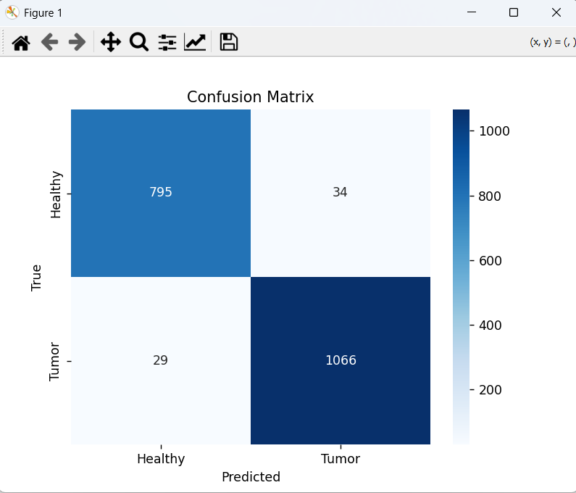
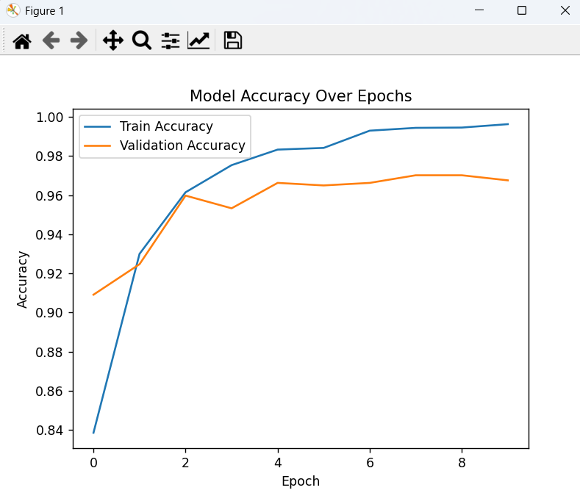
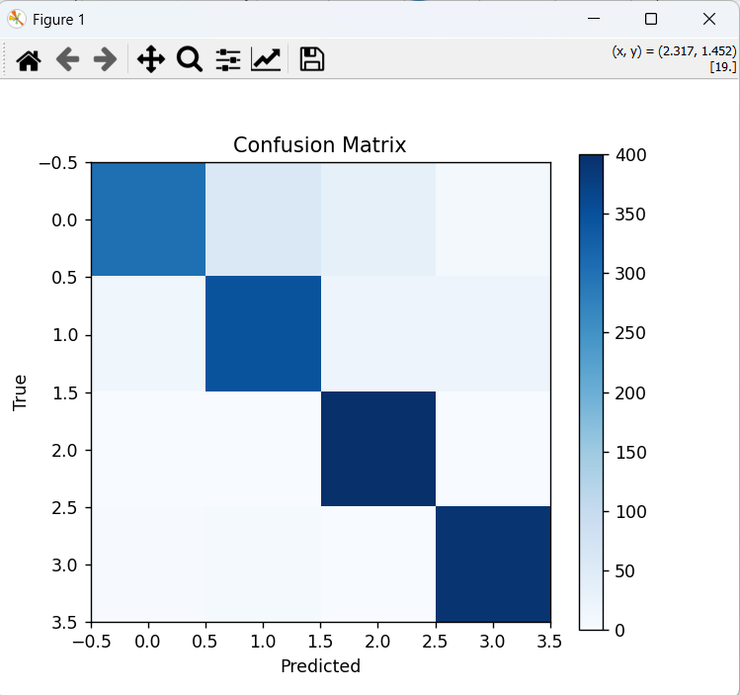
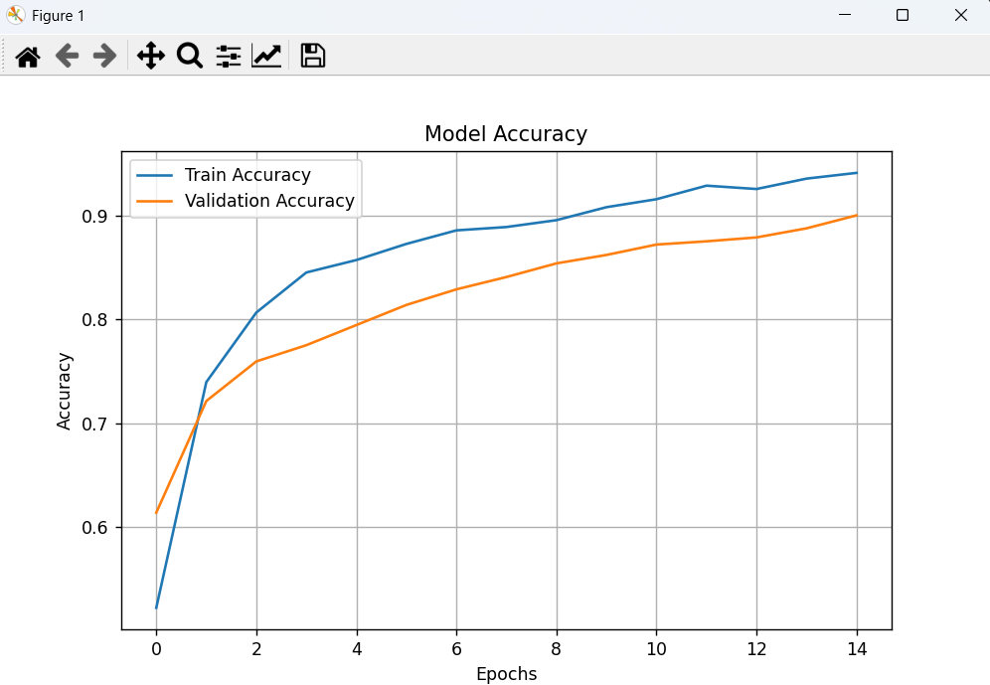
Results & Analysis
CNN BINARY DETECTION
MOBILENETV2 CLASSIFICATION

Slide 16
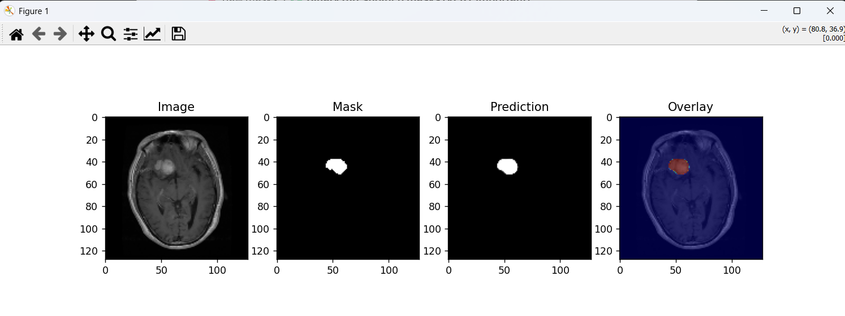
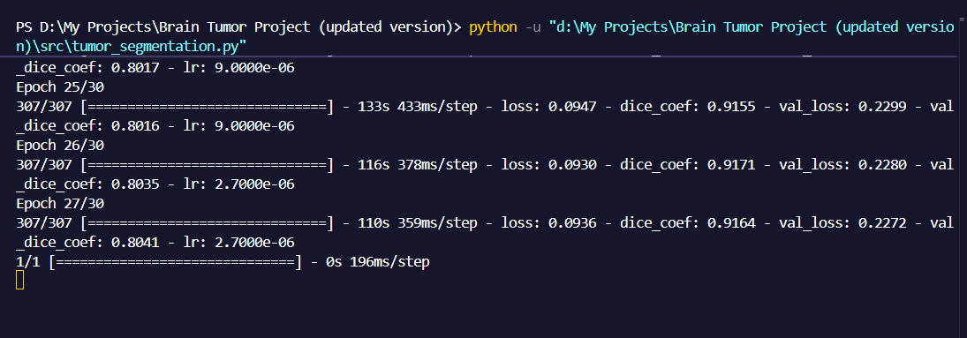
Results & Analysis
U-Net Tumor Segmentation
Original MRI
Ground Truth Mask
Predicted Mask
Tumor Overlay
Train Dice: 0.9164 Val Dice: 0.8041 Epochs: 30 (ReduceLROnPlateau + EarlyStopping)

Slide 17
Comparative Analysis
Our models vs. baseline and literature methods
Method | Accuracy | Architecture | Training Speed | Generalisation
Basic CNN (Baseline) | ~85% | Simple Conv | Fast | Limited
ResNet50 (Literature) | ~91% | Deep ResNet | Slow | Good
VGG16 Transfer | ~88% | VGG16 TL | Moderate | Good
✓ Our CNN Detection | 97.3% | Binary Classifier | Fast (10 ep) | High
✓ Our MobileNetV2 | 90.0% | MobileNetV2 TL | Efficient (15 ep) | High
Basic U-Net (Baseline) | Dice ~0.70 | Vanilla U-Net | Slow | Moderate
✓ Our U-Net | Dice 0.80+ | BN + Dropout | Optimised (30 ep) | Strong
+12.3pp vs Baseline CNN
Efficient TL — 90% in 15 epochs
Dice +0.10 vs Vanilla U-Net

Slide 18
Challenges & Solutions
Technical obstacles encountered and how each was resolved
✗ Large BraTS Dataset (~13 GB)
✓ Used another dataset from kaggle — sufficient for meaningful segmentation training without any problem.
✗ Class Imbalance (Meningioma)
✓ Applied class-weighted loss functions and heavy augmentation; MobileNetV2 handles imbalance better than vanilla CNN.
✗ Overfitting on Small Datasets
✓ Dropout layers, Batch Normalization, EarlyStopping (patience=5) and ReduceLROnPlateau callbacks controlled overfitting.
✗ Dependency Conflicts
✓ Created isolated Python virtual environments with pinned library versions for reproducible, conflict-free builds.
✗ No GPU — CPU-Only Training
✓ Optimized batch sizes and epochs per model; transfer learning (MobileNetV2) dramatically cut training time from scratch.
← Challenge
Solution →

Slide 19
Web Application & Deployment
React + FastAPI full-stack application — operational and demo-ready
Frontend — React + Vite + Tailwind
Backend — FastAPI + TensorFlow
▸ DropZone Upload
/predict/binary
CNN tumor detection
Drag-and-drop MRI scan upload for single or batch analysis
/predict/type
MobileNetV2 classification
▸ ResultPanel
/predict/segmentation
U-Net mask generation
Displays prediction confidence, tumor type, and segmentation overlay
▸ Batch Processing
/predict/full
Complete 3-stage pipeline
Analyze multiple MRI scans in a single session
/generate-report
PDF via ReportLab
▸ QR Code Sharing
Generate scannable QR code to share system on mobile
PDF Report Generation
▸ History Tracking
Auto-generated via ReportLab. Each report includes:
• Detection result + confidence score
• Tumor type + class probabilities
• Segmentation mask overlay + area %
• QR code for system sharing
localStorage-based analysis log with previous results
▸ Dashboard
Visual analytics with Recharts — accuracy and prediction trends

Slide 20






Real-World Applications & Impact
Clinical, educational, and technological deployment possibilities
Hospital Diagnostic Support
MRI Analysis Automation
Clinical Decision Assistance
AI-assisted MRI screening for faster, more accurate tumor detection in clinical radiology workflows.
Automates manual radiologist review — significantly reducing analysis time per patient.
Confidence scores and multi-class outputs support oncologists in treatment planning decisions.
Remote Healthcare Access
Medical Education
Mobile-First Reporting
Cloud deployment enables AI diagnostics in rural and underserved regions with limited specialist access.
Annotated MRI examples with predictions serve as training material for radiology students.
QR-code-enable system accessible on smartphones — no desktop required for result review.

Slide 21
Future Scope
Planned enhancements for the next development cycle
1
Cloud Deployment
2
GPU-Accelerated Inference
AWS / GCP hosting with auto-scaling, HTTPS, and global CDN for production-grade availability.
CUDA-accelerated prediction targeting <1 second latency. Real-time MRI stream processing.
3
Grad-CAM Explainability
4
DICOM Image Support
Class activation maps to visually explain which MRI regions drove the model's decision — critical for clinical trust.
Native support for DICOM (.dcm) format — the standard used by hospitals and PACS systems worldwide.
5
Transformer-Based Models
6
Mobile Application
Vision Transformers (ViT) and Swin Transformers for improved accuracy beyond CNN baselines.
Android and iOS apps for on-the-go MRI analysis with localised multi-language interface.
7
User Authentication
8
Model Optimisation
Secure login, patient record management, and role-based access control for clinical deployment.
Pruning, quantisation, and knowledge distillation for lightweight edge deployment on low-resource devices.
9
Larger Training Datasets
10
Enhanced Clinical Reports
More diverse, multi-institutional datasets for improved generalisation across different MRI scanner types.
Reports with precise tumor size, location coordinates, growth rate estimation, and treatment recommendations.

Slide 22
Conclusion
All objectives achieved — end-to-end pipeline fully operational and validated
✅
97.3% — Detection Accuracy
CNN Binary Classifier — 1,924 test samples from Kaggle MRI dataset
✅
90.0% — Classification Accuracy
MobileNetV2 — 4 classes: Glioma, Meningioma, Pituitary, No Tumor
✅
0.80+ — Segmentation Dice Score
U-Net — Batch Norm + Dropout + combined Dice+BCE loss
✅
3-Stage — End-to-End Pipeline
Input MRI → Detect → Classify → Segment → Annotated Report
This project demonstrates deep learning pipelines are clinically feasible, accurate, and ready for real-world deployment.

Slide 23
References
Sources and datasets used in this project
[1]
Mayo Clinic — Brain Tumor Symptoms & Causes
https://www.mayoclinic.org/diseases-conditions/brain-tumor/symptoms-causes/syc-20350084
[2]
Wikipedia — Brain Tumor (Overview & Types)
https://en.wikipedia.org/wiki/Brain_tumor
[3]
Cleveland Clinic — Brain Cancer / Brain Tumor
https://my.clevelandclinic.org/health/diseases/6149-brain-cancer-brain-tumor
[4]
Kaggle — Brain Tumor Type Dataset
https://www.kaggle.com/datasets/masoudnickparvar/brain-tumor-mri-dataset
[5]
Kaggle — Brain Tumor Segmentation Dataset (Nikhil Roxtomar)
https://www.kaggle.com/datasets/nikhilroxtomar/brain-tumor-segmentation?utm_source=chatgpt.com
[6]
National Cancer Institute — Brain & Spinal Cord Tumors
https://www.cancer.gov/types/brain/hp
[7]
Johns Hopkins Medicine — Brain Tumor Surgery
https://www.hopkinsmedicine.org/health/conditions-and-diseases/brain-tumor/brain-tumor-surgery
[8]
Cancer Research UK — Brain Tumours Overview
https://www.cancerresearchuk.org/about-cancer/brain-tumours

Slide 24
Thank You
Questions & Discussion
97.3%
90.0%
0.80+
Detection
Classification
Dice Score
Aryan Sengar | 23CSU055 | B.Tech CSE | 2025–26
Mentor: Dr. Ashima Rani | Technologies: Python · TensorFlow · FastAPI · React · OpenCV · U-Net

